Slide 1
WASC Powerpoint Training : Structure
        Preliminary Considerations
        Layout
        Background Colour
        Font Positioning and Colour
        Font Style and Size
        Colours
        Image insertion – covers
        Image insertion – stamps
        Transitions
        Animation
        Recording
        Manipulating Slides

Slide 2
WASC Powerpoint Training :
Preliminary Considerations
Constraint of oblong shape of slide

Slide 3
WASC Powerpoint Training : Preliminary Considerations
Constraint of oblong shape of slide
Consider your intended audience: looking at screen 35cm from their noses, or 10-50 meters from their noses – font size needs to alter

Slide 4
WASC Powerpoint Training : Preliminary Considerations
Constraint of oblong shape of slide
Consider your intended audience: looking at screen 35cm from noses or 10-50 meters from noses – font size needs to alter
Not using MS 365 – which can insert multiple changes of one slide; but cannot enlarge images

Slide 5
WASC Powerpoint Training : Preliminary Considerations
Constraint of oblong shape of slide
Consider your intended audience: looking at screen 35cm from noses or 10-50 meters from noses – font size needs to alter
Not using MS 365 – can insert multiple changes of one slide; cannot enlarge images
Working in a MS W10 operating system, not Mac(kintosh) Apple or other OS

Slide 6
WASC Powerpoint Training : Layout
Go to ‘Design’ button:
Pre-selected layouts and colour combinations
- toggle button down
Notes:
Move the slide arrow to the right of the first 6 layouts showing to see the full range of pre-set layouts.

Slide 7
WASC Powerpoint Training : Layout
Go to ‘Design’ button:
Pre-selected layouts and colour combinations – toggle button down
Next across toggle button – colours, fonts, effects, background styles
Notes:
Click on the downward facing arrow to the right of the next four frames showing, and on gets a menu box appearing allowing one to choose a colour combination, different fonts, effects and background styles – most of these we come to consider in later slides of this presentation.

Slide 8
WASC Powerpoint Training : Layout
Go to ‘Design’ button:
Pre-selected layouts and colour combinations – toggle button down
Next across toggle button – colours, fonts, effects, background styles
Slide show – can alter size of slide – standard/widescreen
lets see what happens if we try for a widescreen format
Add number to each slide
Notes:
Next across on the ‘Design’ button, one can click on the slide size button and its downward pointing arrow: click on it & one can choose the Standard 4:3 slide size, the Widescreen 16:9 slide size, or custom one’s own slide size. Try choosing the widescreen option and see how the slides alter! Revert to Standard size. NB Widescreen slide size allows more space for images but may not accord to the screen size of viewer’s PC/laptop especially if those are not very new.
On far right hand side of ribbon there is a Background button which can be used to format the background colour, pattern, transparency, gradient, texture.
To number each slide, go to Insert banner, then click on Slide Number button (16th across).

Slide 9
WASC Powerpoint Training : Layout
Go to ‘Design’ button:
Format background : drop down side menu allowing all sorts of amendments: shape and text options (at top):
Overflowing paint bucket: fill variations including colour and transparency;
Bishop’s mitre: shadows, reflections, glow, soft edges, 3-D
Cross on square: size and properties
Under text option: variations of lettering – would normally do via ‘Home’ tab
Notes:
Click Design banner & then Format background/click on background concerned in your slide: get overflowing bucket, bishops mitre for effects, and cross on black background for text choices. After trying various options, click on cross at top right of the Format Background menu to remove it.

Slide 10
WASC Powerpoint Training : Background Colour
Notes:
Go to Home banner and click on background in slide showing: Click on Shape Fill and its downward pointing arrow, then hover over colours showing, and then go to More Fill Colours and hover over Standard or Custom colour palettes that appear in a drop down menu box. Likewise investigate options for Shape Outline and Shape Effects by clicking on their downward adjacent arrows.

Slide 11
WASC Powerpoint Training :
Background Partition & Colour
Nigeria 1952 2d Grey
Text
Nigeria 1952 2d Grey
Image
Notes:
To split screen: either insert text box on top or Home/Paragraph/bottom 5th button across. Use dark text on a light background, or a light text on a dark background

Slide 12
WASC Powerpoint Training :
Font Positioning and Variations
Nigeria 1950s 2d Grey - Goudy Old Style 40
Nigeria 1950s 2d Grey - Goudy Old Style 40
Nigeria 1950s 2d Grey - Goudy Old Style 40
Nigeria 1950s 2d Grey - Goudy Old Style 50
Nigeria 1950s 2d Grey - Goudy Old Style 50
Notes:
Now to Fonts: Select Home banner and operate via Font menu (3rd across this banner) including clicking on the downward right pointing arrow in the bottom right corner of the Font Menu. Experiment with font positioning within slide (left adjusted, central, right adjusted – all of same font type & size. Then try bolding (‘B’), italic (‘I’), underlining (‘U’) – avoid, text shadowing (‘S’), changing cases and changing font colour vis downward arrow to right of ‘A’ underlined in colour. All as per any word processor program.

Slide 13
WASC Powerpoint Training : Font Style & Size
Nigeria 1950s 2d Grey - Goudy Old Style 24
Nigeria 1950s 2d Grey - Goudy Old Style 24 bold
Nigeria 1950s 2d Grey - Calibri 24
Nigeria 1950s 2d Grey - Arial 24
Nigeria 1950s 2d Grey - Tahoma 24
Nigeria 1950s 2d Grey - Lucida Calligraphy 24
Nigeria 1950s 2d Grey - Book Antigua 24
Nigeria 1950s 2d Grey - Freestyle Script 24
Nigeria 1950s 2d Grey - Broadway 24
Nigeria 1950s 2d Grey - Goudy Old Style 32
Nigeria 1950s 2d Grey - Goudy Old Style 40
Nigeria 1950s 2d Grey - Goudy Old Style 50
Notes:
Experiment with same wording in different font styles and sizes. Look at legibility (see Lucida Calligraphy, Freestyle Script, Broadway above) and note different styles of same chosen size result in different word lengths and apparent text sizes Compare Arial 24 to Calibri 24 above).

Slide 14
WASC Powerpoint Training :
Font Positioning and Variations
Use of text box:
I can have my own background colour, font, and various types of borders – great for individual stamp & cover borders.
I can be dragged around the slide, even turned sideways or upside down
Notes:
Go to Insert banner and 12th icon across is Text Box, click on it, go to slide and one gets a downward pointing arrow: click on one part of slide and drag pointer and one gets a text box. Pull the sides or corners of the text box to get the size and shape one wants; hover near a corner and one gets a pointed black cross – press on mouse right hand button and one can drag the text box wherever it is required. Click on text box within slide and the Shape Format tab is highlighted, click on that tab and use the menu that appears to format the background, box outline, and text within the text box, and to enable this text box to appear behind or in front of other images. Click on the text box and use the handle that appears at the top to turn the box at an angle or even upside down! To remove a text box, click on the text box and then go the scissor symbol at top left of te Home banner next to the Paste icon.

Slide 15
WASC Powerpoint Training :
Font Style & Size Recommendations
Title font size: 36 pt + bolded (larger if room audience)
Sub-Headings: 32 pt + bolded (larger if room audience)
Text: Minimum 24 pt (32 pt minimum if room audience)
Bold most headings and sub-headings
Notes:
Recommended font styles and sizes & bolding. Quite large please especially if projecting to a room audience.

Slide 16
WASC Powerpoint Training :
Font Style & Size Recommendations
Title font size: 36 pt + bolded (larger if room audience)
Sub-Headings: 32 pt + bolded (larger if room audience)
Text: Minimum 24 pt (32 pt minimum if room audience)
Bold most headings and sub-headings
Keep to simple font styles, not flowery nor
too blocky nor elaborate
X Nigeria 1950s 2d Grey - Freestyle Script 28
X Nigeria 1950s 2d Grey - Broadway 32
Notes:
Keep to simple font styles, not too flowery nor blocky

Slide 17
WASC Powerpoint Training :
Font Style & Size Recommendations
Title font size: 36 pt + bolded (larger if room audience)
Sub-Headings: 32 pt + bolded (larger if room audience)
Text: Minimum 24 pt (32 pt minimum if room audience)
Bold most headings and sub-headings
Keep to simple font types, not flowery nor
too blocky nor elaborate
X Nigeria 1950s 2d Grey - Freestyle Script 28
X Nigeria 1950s 2d Grey - Broadway 32
Do not mix too many font styles and sizes on same slide &/or presentation: three (3) maximum
Notes:
Avoid mixing more than 3 font styles or sizes on one slide and/or in one presentation

Slide 18
WASC Powerpoint Training: Colours
Nigeria 1950s 2d Grey - Goudy Old Style 24 bold Black
Nigeria 1950s 2d Grey - Goudy Old Style 24 bold Red
Nigeria 1950s 2d Grey - Goudy Old Style 24 bold Red-brown
Nigeria 1950s 2d Grey - Goudy Old Style 24 bold Bright blue
Nigeria 1950s 2d Grey - Goudy Old Style 24 bold Dark green
Nigeria 1950s 2d Grey - Goudy Old Style 24 bold Brown
Nigeria 1950s 2d Grey - Goudy Old Style 24 bold Grey
Nigeria 1950s 2d Grey - Goudy Old Style 24 bold Orange
Nigeria 1950s 2d Grey - Goudy Old Style 24 bold Pink
Nigeria 1950s 2d Grey - Goudy Old Style 24 bold Yellow
Nigeria 1950s 2d Grey - Goudy Old Style 24 bold Purple
Nigeria 1950s 2d Grey - Goudy Old Style 24 bold Green
Notes:
All pt 24. Which clear on this background? Alter background & see which are then clear. Preferable to use warm (reds and browns) and not cold (blue and black) colours.

Slide 19
WASC Powerpoint Training : Colours
Use dark colours on light backgrounds; light colours on dark backgrounds
Notes:
Said already. Sequence of recommendations coming up.

Slide 20
WASC Powerpoint Training : Colours
Use dark colours on light backgrounds; light colours on dark backgrounds
Pay attention to complementarity and contrast of text/images to background (green on orange as here not so good, dark green on orange below is much better)
Pay attention to complementarity and contrast of text/images to background

Slide 21
WASC Powerpoint Training : Colours
Use dark colours on light backgrounds; light colours on dark backgrounds
Pay attention to complementarity and contrast of text/images to background (green on blue as here not so good)
Use a range of colours to distinguish sections or chapters especially of backgrounds,
and groups of related words on a slide

Slide 22
WASC Powerpoint Training : Colours
Use dark colours on light backgrounds; light colours on dark backgrounds
Pay attention to complementarity and contrast of text/images to background (green on blue as here not so good)
Use a range of colours to distinguish sections or chapters especially of backgrounds and groups of related words on a slide
Use a few, not a kaleidoscope of colours on one slide

Slide 23
WASC Powerpoint Training : Colours
Use dark colours on light backgrounds; light colours on dark backgrounds
Pay attention to complementarity and contrast of text/images to background
Use warm (brown, pink) as well as cold (blue, black) colours
Use a range of colours to distinguish sections or chapters especially of backgrounds and groups of related words on a slide
Use a few, not a kaleidoscope of colours on one slide
Use red sparingly – attracts the eye
Beware of audience members being colour blind (green & red)

Slide 24

Biafran Postal History
30 May 1967 –
15 January 1970
Cockermouth PS 13 October 2022 Tony Plumbe
Notes:
Example of an opening presentation page. Fairly clear, some font sizes maybe too small, background colour too close to that of lower part of flag?

Slide 25
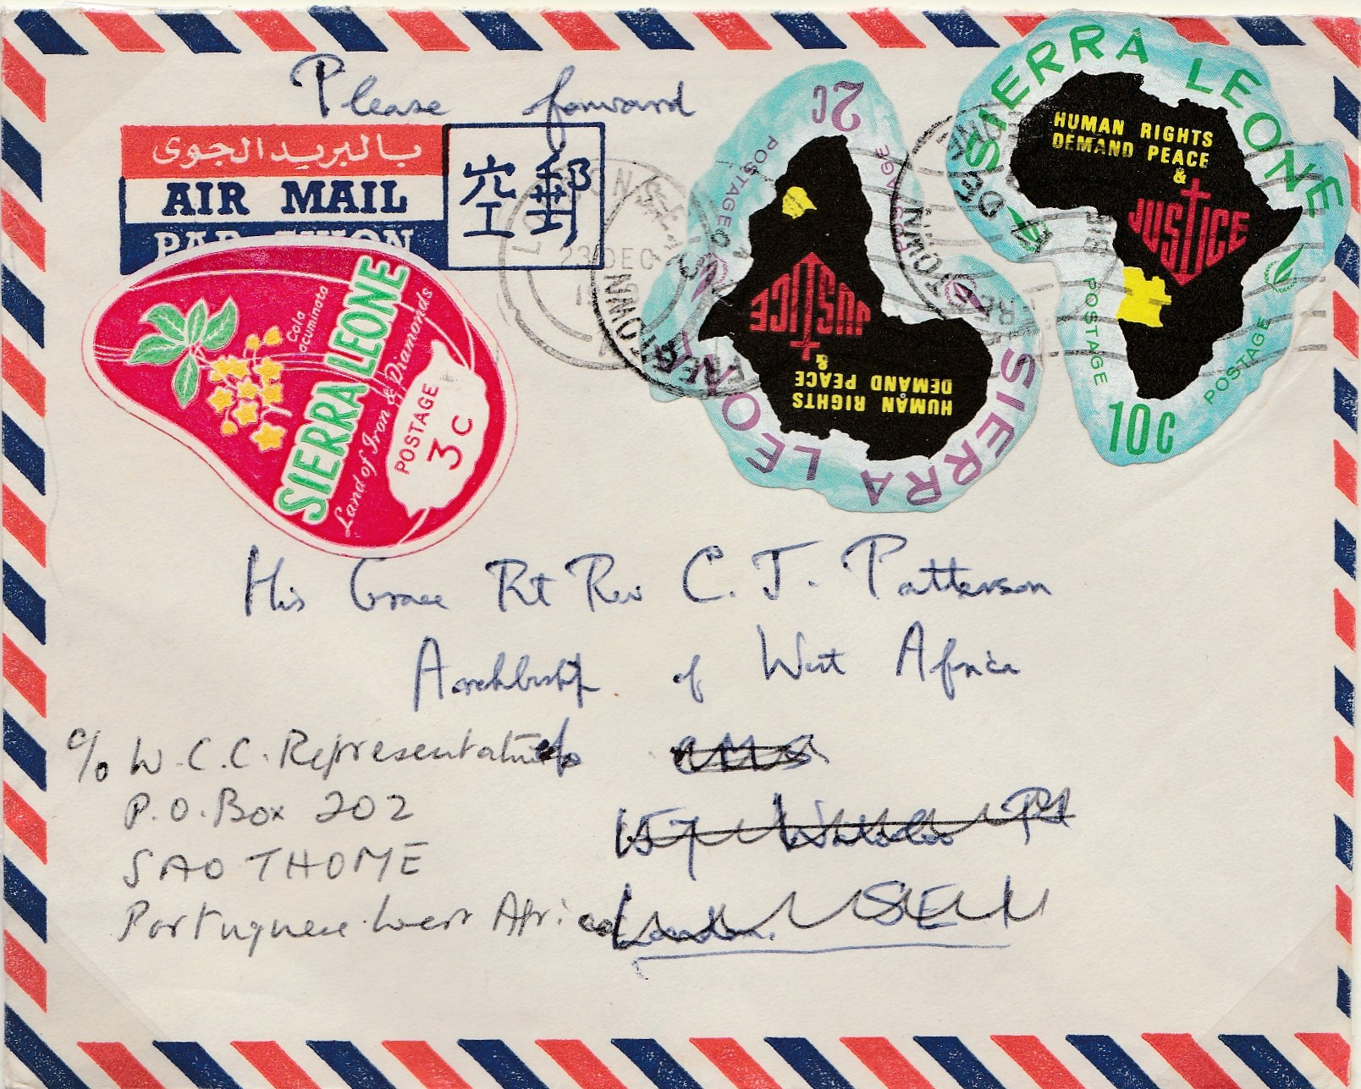
WASC Powerpoint Training : Image Insertion
Notes:
Go to Insert ribbon/ then Pictures/This Device/Folder/click on folder with images stored/click on image – arrives too small for slide.

Slide 26
WASC Powerpoint Training : Image Insertion
Notes:
Insert/Pictures/This Device/Folder/click on folder with images stored/click on image – arrives too small for slide. Click on image/Picture format/Picture border/weight to get a border of required weight and colour. ALL Images need an outline. Go to Picture Format/picture effects/ shadow or glow. Adjust image to slide size – usually enlarge. Crop any white bands: click on image in slide – get Picture Tools and click on Picture Format just below it, and then on right hand side click on Crop button and then Crop – adjust handles that appear on image and when finished click away from image to effect cropping. Drag image to left of slide where wanted.

Slide 27
WASC Powerpoint Training : Image Insertion
1968 (17 Dec) Freetown,
Sierra Leone
Notes:
Can write text straight on to background but identify position on slide first. Quickly run into positioning problems – hides behind image: try backspace just left of Sierra Leone – revert to original position! Much better insert a text box and work within that.

Slide 28
WASC Powerpoint Training : Image Insertion
1968 (17 Dec) Freetown, Sierra Leone to Bishop Patterson in London at 15c airmail rate
Notes:
Click Insert banner and then Text box & design as above. No outline round text box, but can put one round blocks of info. Text box can have same background colour as the Background, or a contrasting colour if one wants the text box to stand out.

Slide 29
WASC Powerpoint Training : Image Insertion
1968 (17 Dec) Freetown, Sierra Leone to Bishop Patterson in London at 15c airmail rate.
Endorsed ‘Please forward’.
Notes:
Add second bit of info same font type & size & colour. To insert arrow: Go to Insert ribbon and choose Shapes tab downward arrow, and then choose arrow from drop down menu, click on one part of slide and drag to another to create the arrow. Format the weight and colour of the arrow like any other image: click on it and use the Shape Format tab to access the required menu. Use the handles at the end of the arrow to shift its position around the slide. Big ‘blank space’ at bottom right. Action: increase font size or add more words/another image.

Slide 30
WASC Powerpoint Training : Image Insertion
1968 (17 Dec) Freetown, Sierra Leone to Bishop Patterson in London at 15c airmail rate.
Endorsed ‘Please forward’.
Re-addressed to W.C.C. Representative Sao Tome and London machine cancellation dated 23 December 1968.
Notes:
Add second & third bit of info in same font type & size & colour. Add two more arrows, one with straight line segment from Shapes menu.
Unclear: conflicting arrows which dominate the image.

Slide 31
WASC Powerpoint Training : Image Insertion
1968 (17 Dec) Freetown, Sierra Leone to Bishop Patterson in London at 15c airmail rate. Endorsed ‘Please forward’. Re-addressed to W.C.C.Representative Sao Tome and London machine cancellation dated 23 December 1968. Known to have arrived in Bishop Patterson’s hands in Biafra otherwise would not be in any collector’s hands
Notes:
Now have two crossing arrows in different colours: better than last slide but not very desirable: could some text be moved to enable arrows to not cross; blue arow less intrusive than red re detracting eye from the subject image. Additional information been added in different colour here but does that lead to the text being in too small a font size?

Slide 32
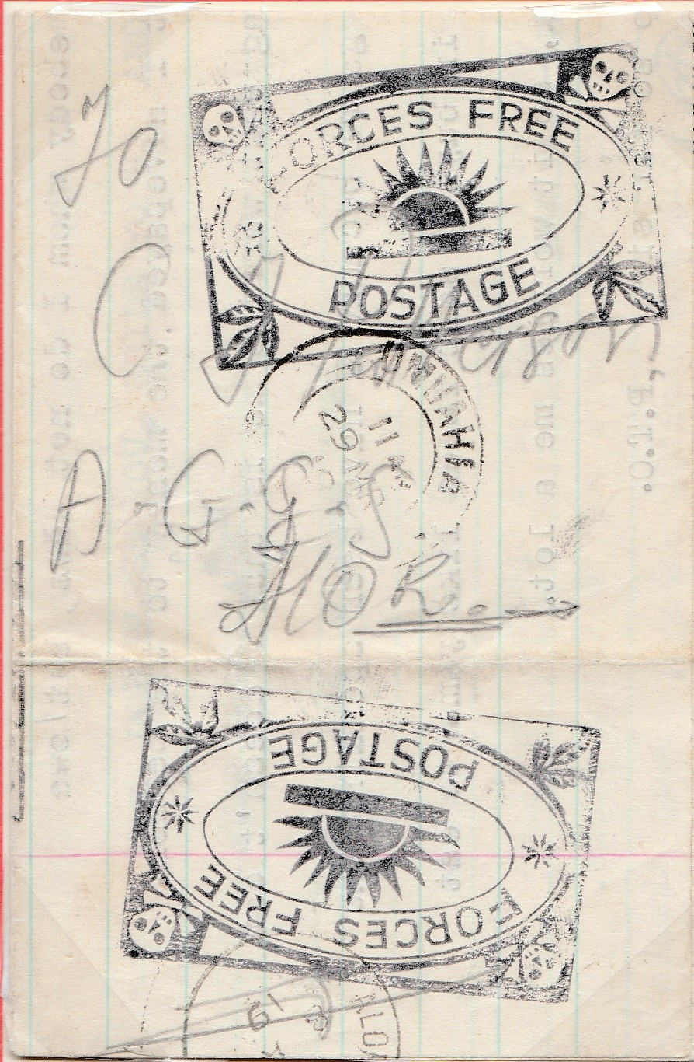
WASC Powerpoint Training : Image Insertion
Notes:
Another example of image insertion with issues. Insert/ Pictures/ This Device/ Select required Image: Commando entire, unfolded from 3 folds. First add border, not good contrast with background, loads of space to right.

Slide 33
WASC Powerpoint Training : Image Insertion
1968 (29 March) Commando entire entered post at Umuahia sent to C.J.Patterson at Alor Girls Grammar School, Alor arriving 6 June.
Notes:
Add description first in text box at 32pt. Might do cropping of top edge of first image as white edge. Still lot of empty space!

Slide 34
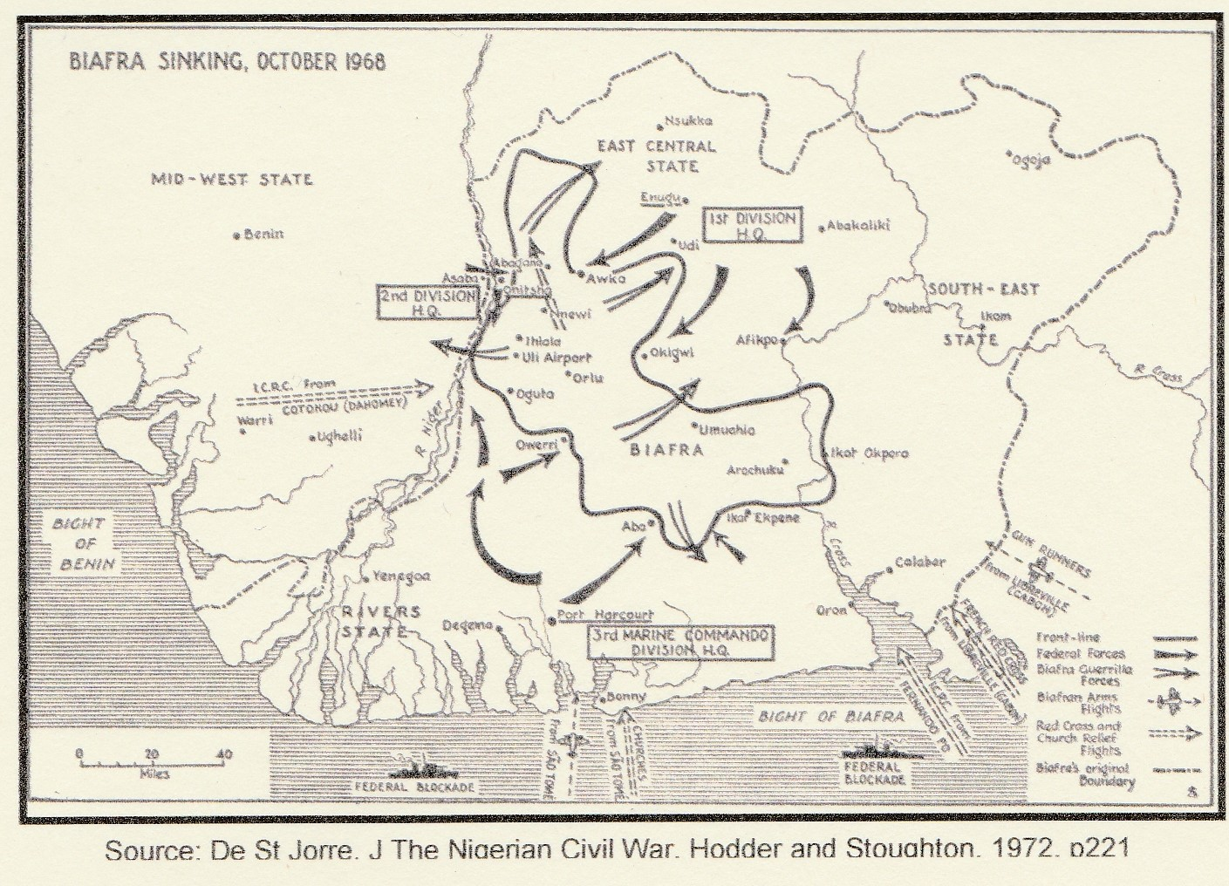
WASC Powerpoint Training : Image Insertion
1968 (29 March) Commando entire entered post at Umuahia sent to C.J.Patterson at Alor Girls Grammar School, Alor arriving 6 June.
Notes:
Add map of civil war position Oct 1968 NB not at time of entire selected which is what is really needed. Insert image from folder as before. Click on image/Picture format/colour lhs and chose yellow as dullish slide. Toggle colours. RHS still blank area.

Slide 35
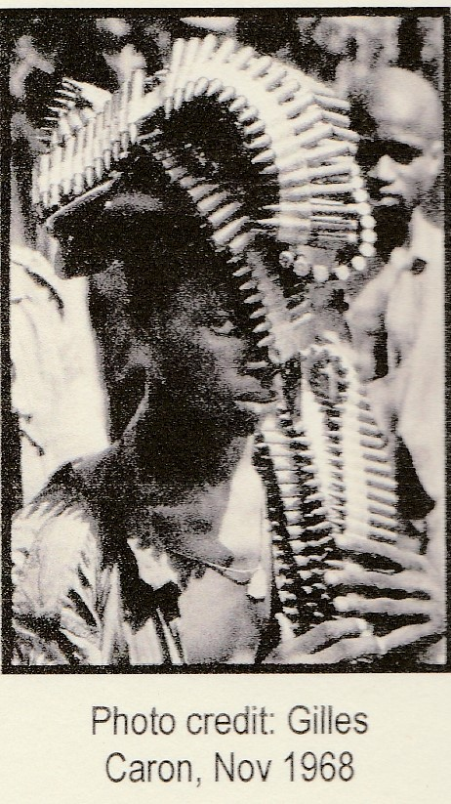
WASC Powerpoint Training : Image Insertion
1968 (29 March) Commando entire entered post at Umuahia sent to C.J.Patterson at Alor Girls Grammar School, Alor arriving 6 June.
Notes:
Add further image headlaoding machine gun bullets. Keep black to complement LHS. Too crowded? Map better if larger and only image on the slide.

Slide 36
WASC Powerpoint Training : Image Insertion
1968 (29 March) Commando entire entered post at Umuahia sent to C.J.Patterson at Alor Girls Grammar School, Alor arriving 6 June.
Notes:
Better layout: enlarged ‘entire’ and map images, lessened text font size slightly, shifted headloading of ammunition to top right.

Slide 37
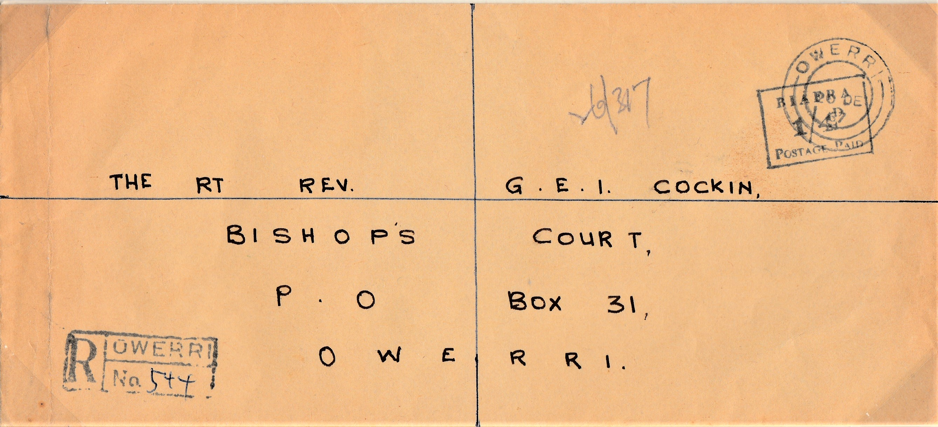
WASC Powerpoint Training : Image Insertion
Notes:
Another example of issues with a long oblong cover - at least it is not vertical! Lets get to work on it: Add a border as before and enlarge. Click on image and use its top handle to show it angling sideways up, and drag the image around – no improvements. Get back to original position.

Slide 38
WASC Powerpoint Training : Image Insertion
1967 (28 December) Registered cover sent internally within Owerri at 1/4d rate. Single ‘Biafra Postage Paid 1/4d cachet. Owerri registration handstamp.
Notes:
Increase image size a little. Add description, usual sizing and positioning of text. Ran out of space at 32pt: reduce image size or cut two last superfluous phrases which can be seen easily.

Slide 39
WASC Powerpoint Training : Image Insertion
1967 (28 December) Registered cover sent
internally within Owerri at 1/4d rate.
Notes:
Superfluous text cut, font increased to 36pt. Bold clear presentation results.

Slide 40
WASC Powerpoint Training : Image Insertion
Advice on Covers:
Usually one per slide is enough
Consider shape of cover relative to oblong slide shape: complementary text or images may be needed
Give borders and (usually) enlarge the cover
Presentation at an angle rarely works
Notes:
Add description, usual sizing and positioning of text. Ran out of space at 32pt: reduce image size or cut two last superfluous phrases.

Slide 41
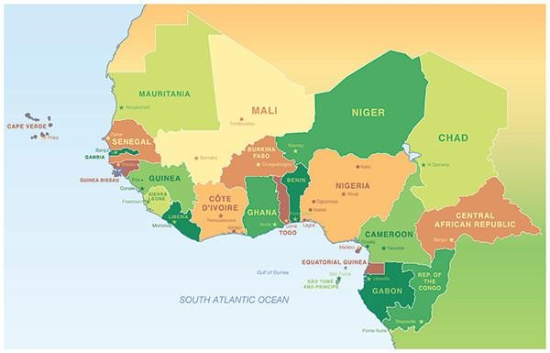
External Mail: Routes In and Out of Biafra
WASC Powerpoint Training : Image Insertion
Notes:
Example of what can go wrong when copying from another Powerpoint presentation. Is a base map but supposed to have routes as arrows and places inside boxes. Arrows and names are a layer on top of base map layer: be careful how copied across as often will lose upper layer(s). Background colour copied across but cannot be changed w/o going back to original, changing there and copying again across.

Slide 42
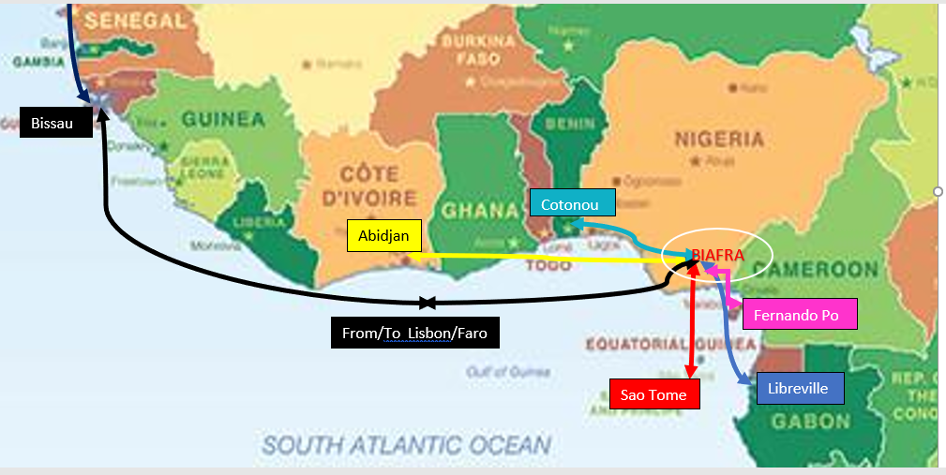
External Mail: Routes In and Out of Biafra
WASC Powerpoint Training : Image Insertion
Notes:
Is a base map with routes as arrows and places inside boxes. Arrows and names are a layer on top of base map layer: be careful how copied across as often will lose upper layer(s). Here the text boxes with place names, and the arrows, have been inserted on the base map shown in the last slide to get the slide back to what the original slide in another Powerpoint presentation showed. Still none too clear as a map owing to its scale: perhaps show long distance routes on one map and shorter distance routes on another map on a second slide?

Slide 43

WASC Powerpoint Training : Stamp Insertion
Avoid this!
Do not copy pages of stamps straight across into the slide – too small, can’t be seen!!
Had to reduce size of vertical piece to fit slide and key information is in mss at middle top right.
Notes:
Another one to avoid!

Slide 44

WASC Powerpoint Training : Image Insertion
Nigeria 1953-58 4d Definitive: Bag flaw (V41)
Notes:
Manipulating the image. Same procedure as before: Insert / Pictures/ This Device/ go to Folder holding scans and select image required. Scan shown here is of actual size. Can you even see the flaw? It is visible to the human eye

Slide 45
WASC Powerpoint Training : Image Insertion
Nigeria 1953-58 4d Definitive: Bag flaw (V41)
Notes:
Click on the stamp image and then right click on the image, copy it and paste it also on the slide. Now draq a corner of the pasted image until the image is much larger. On that enlarged image, click on the Picture Format tab and then use the Crop button and Crop option: move the handles now on the image to select just the small part of the enlarged image that shows the variety. Will appear as above to left of the slide. Enlarge this selected part of the stamp image still further by dragging a corner, and also reduce the size of the original stamp image to occupy less than half the slide space.

Slide 46
WASC Powerpoint Training : Image Insertion
Nigeria 1953-58 4d Definitive: Bag flaw (V41)
Notes:
Now position and enlarge variety image on right hand side of slide and position original image of stamp pair on left hand side. Add borders to both images. Insert red rings around variety on each image: Go to Insert banner, then Shapes tab, then select circle from Basic Shapes offered. Treat the circles as images to choose their weight and colour.

Slide 47
WASC Powerpoint Training : Image Insertion
Nigeria 1953-58 4d Definitive: Bag flaw (V41)
Notes:
Enlarge both images as much as possible and enlarge red rings and pull them around by their corners and sides. To access the layer with the red rings one may need to click on the image, then on Picture Format, and then Bring forward or Send backward as appropriate, or even drag the image off to the side and use the Bring Forward or Send Backwards applied to the Background image (and click around the circle to find the box it is configured within. Still hardly a good powerpoint presentation!

Slide 48
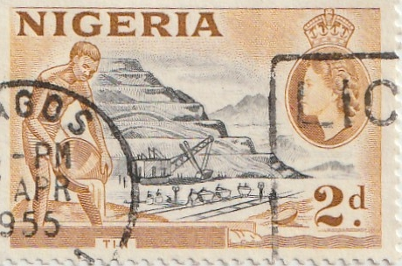
WASC Powerpoint Training : Image Insertion
Nigeria 1954 2d Black & ochre re-entry
Stamp size image
Notes:
Now for a variety that is often hard to see: the Nigeria 2d ochre re-entry. Have inserted title in text box already. Copied across image – at stamp size as before. Copied stamp size image and blown up on RHS. Now go to work on this. Remove ‘stamp size image’ text box. Crop enlarged image until just have area of re-entry. Give cropped and blown up image a border, and blow up to max possible size – see next slide.

Slide 49
WASC Powerpoint Training : Image Insertion
Nigeria 1954 2d Black & ochre re-entry
Notes:
Re-entry and stamp enlarged to maximum possible. Added red arrows: Insert / Shapes/ Choose appropriate Block Arrow from the drop down menu, paste on image. Format arrows in same way as any other image and use handles at either end to orientate the arrow. Click on one arrow, click Copy, and Paste on image as many times as arrows are required. Drag arrows to required positions.

Slide 50

WASC Powerpoint Training : Image Insertion
5 February 1968 Independence Issue 2d
White dot at Calabar variety R8/1
Notes:
Final example of image presentation: Image of a variety already inserted, & border added. Also text box and content on RHS + background changed. Now want to show variety blown up in centre inside a ‘call-out’ balloon shape with arrow pointing to variety. Procedure: duplicate image, crop to image area, blow up, already has a border, insert from under shapes a call-out balloon (towards bottom), draw on slide, click on call out balloon on slide and format its border and change its background colour, then send it backward, adjust shape and point to variety, add arrow. Completed version in next slide.

Slide 51
WASC Powerpoint Training : Image Insertion
5 February 1968 Independence Issue 2d
White dot at Calabar variety R8/1
Notes:
Insert a ‘call-out’ balloon shape: go to Insert/ Shapes/ scroll down to Call Outs and choose one with circular shape, paste on slide and manipulate handles to get required size and shape and positioning of the call-out, and choose its background colour. Then duplicate the variety image, enlarge it, crop to variety area, already has a border, Insert the enlarged cropped image of the variety within the call-out balloon (it may be necessary to click on the call out image and send it backward (click on call out shape, then Slide Format, then Send Backward on right hand side of banner). Adjust shape and point to variety, add arrow as before. Completed version in next slide.

Slide 52

WASC Powerpoint Training : Image Insertion
5 February 1968 Independence Issue 2d
White dot at Calabar variety R8/1
Notes:
Blow up is at limit given quality of scan, getting blurred. Outline of call out given a complimentary colour.

Slide 53
WASC Powerpoint Training : Transitions
Whole series of options as to how one moves (transitions) from one slide to the next.
This presentation is on ‘Wipe’ right to left
Can add a sound and adjust its duration to specific slide or all slides (Good for waking sleepy folk up!)
Can specify if the slide advances only on a mouse click or after x period of time
Advice: Use only slide to slide transitions & own keyboard (All only work in Slide Show mode)
Notes:
Transitions: back to top banner. Click on Transitions and sliding bar on middle RHS bottom button show full choice.

Slide 54
WASC Powerpoint Training : Animations
Another tab in top ribbon
Allows entrance, emphasis and exit effects
Advice: Avoid use of such
Notes:
Animations: usually not suitable for philatelic presentations. Skip Slide Show banner for now & return to in a few minutes.

Slide 55
WASC Powerpoint Training : Recording
Another tab in top ribbon (8th across)
One can record one’s commentary against each slide before the presentation (and then sit back during the display!). Good for keeping to time! Over-recording/correction is possible.
Tab also allows insertion of a screenshot held elsewhere on your device, or a (pre-recorded) screen recording, or a video; and saving as a show or exporting to video (see drop down boxes when one hovers over each icon). Can also be done via Insert tab on ribbon.
Former used in philatelic displays, latter rarely – for the very sophisticated presentation!
Notes:
Recording: sophisticated banner. For the teckie philatelist!

Slide 56
WASC Powerpoint Training : Manipulating Slides
To duplicate a slide or delete a slide: Click on slide with mouse right hand side button and then chose action required. Copy and paste also there, as is adding in a new slide with a different layout.
Re-ordering slides: just drag them up or down the slide images on the left hand side
On ‘View’ tab on top ribbon, click ‘Notes’ and one gets an area below each slide where one can note what one wants to say or do – not visible to audience (nor to you when in Slide Show mode).
Normally, when making a Powerpoint presentation, one switches to ‘Slide Show’ mode where the slides occupy the whole screen: use either icon below right labelled ‘Slide Show’ or tab on top ribbon (7th across) which enables a range of options. To get out of Slide Show mode, click ‘Esc’ button at top left of your keyboard.
Notes:
Duplicating slides; re-ordering slides; adding speaking Notes (enabled in this powerpoint file; operating in Slide Show mode.

Slide 57
WASC Powerpoint Training : The End
Hope this was of help!
Thank You
Questions / Clarifications?

